Slide 1
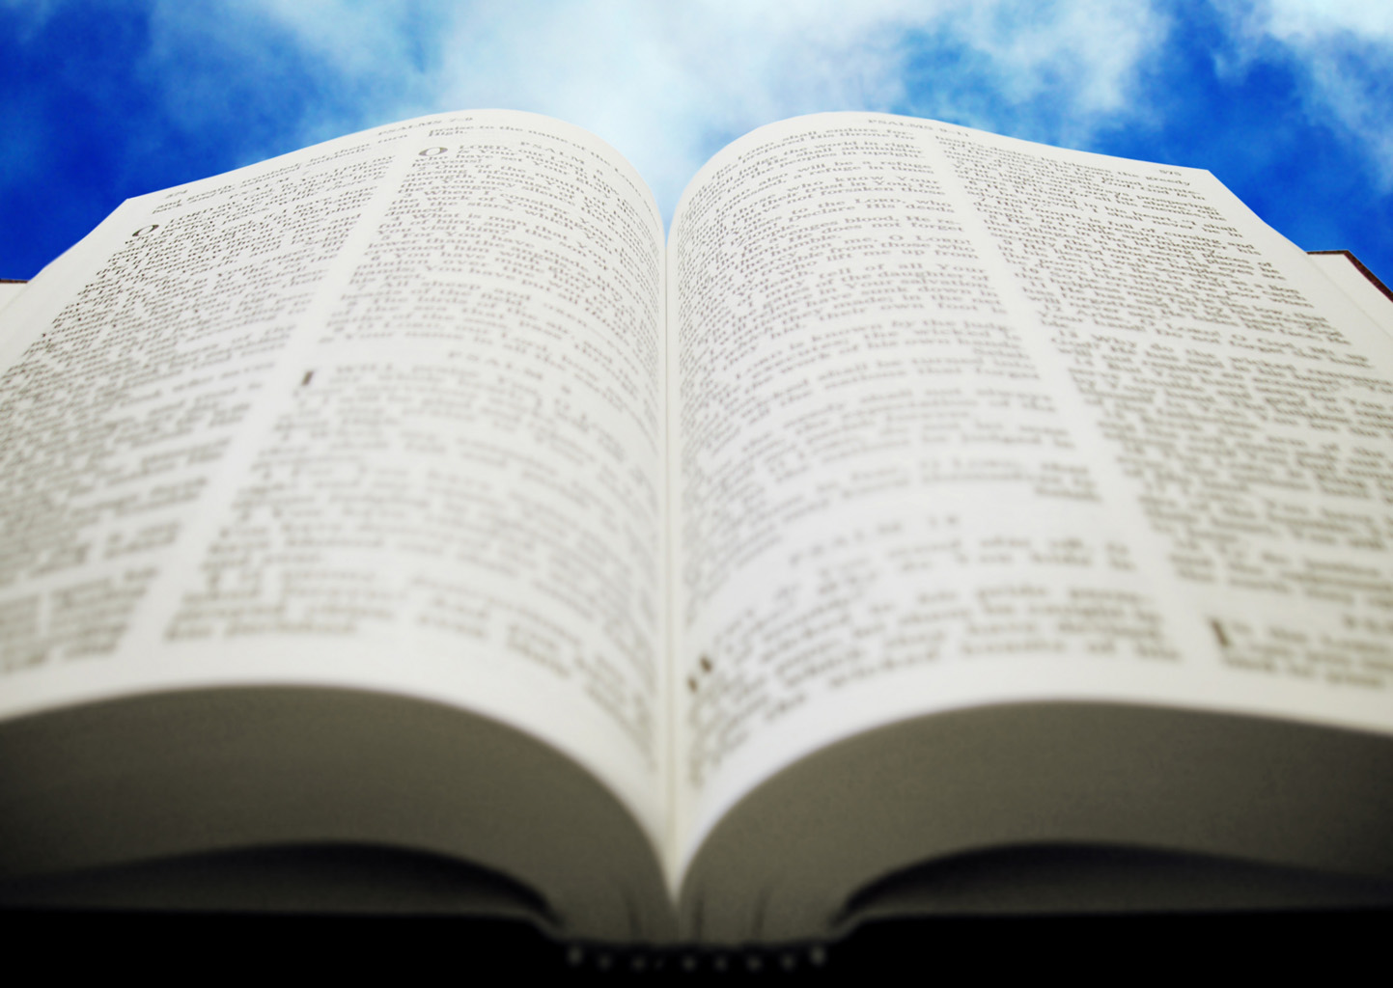
Welcome!
Sunday
Worship 10:00 AM
Sunday
Bible Class (Livestream) 5:00 PM
Wednesday
Bible Class 7:00 PM
www.SunsetchurchofChrist.net

Slide 2
Opening Prayer | Michael Hetzer
Song – 47 | George Watkins
Song – 5 | George Watkins
Song – 189 | George Watkins
Lord’s Supper | Ryan Sollars
Song – 12 (s) | George Watkins
Lesson | Brian Haines
Song – 276 | George Watkins
Closing | Anthony Ward
1 Corinthians 16:2
On the first day of the week let each one of you lay something aside, storing up as he may prosper, that there be no collections when I come.
The collection basket
is in the foyer

Slide 3
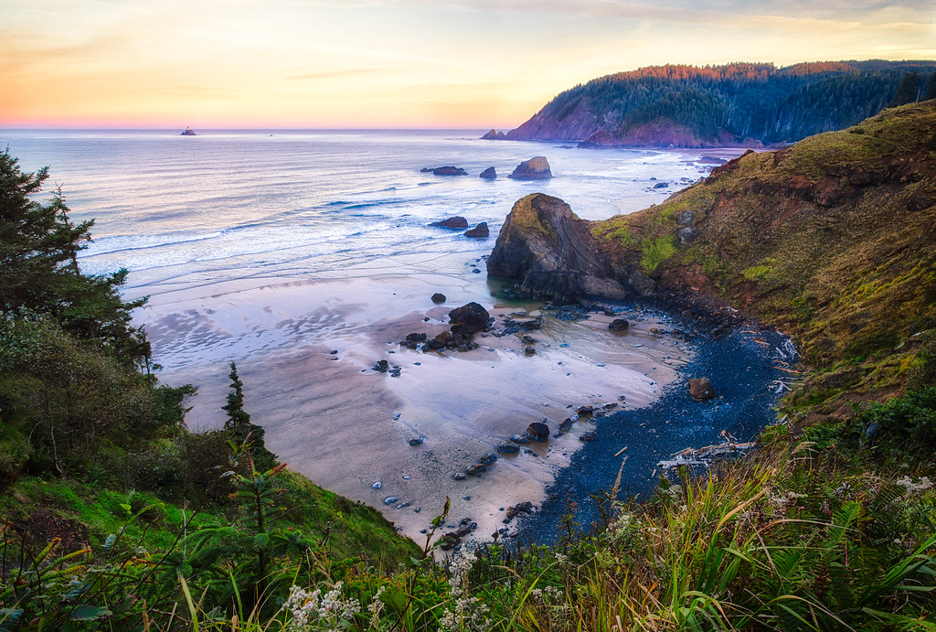
God’s Nature in Nature Romans 1

Slide 4
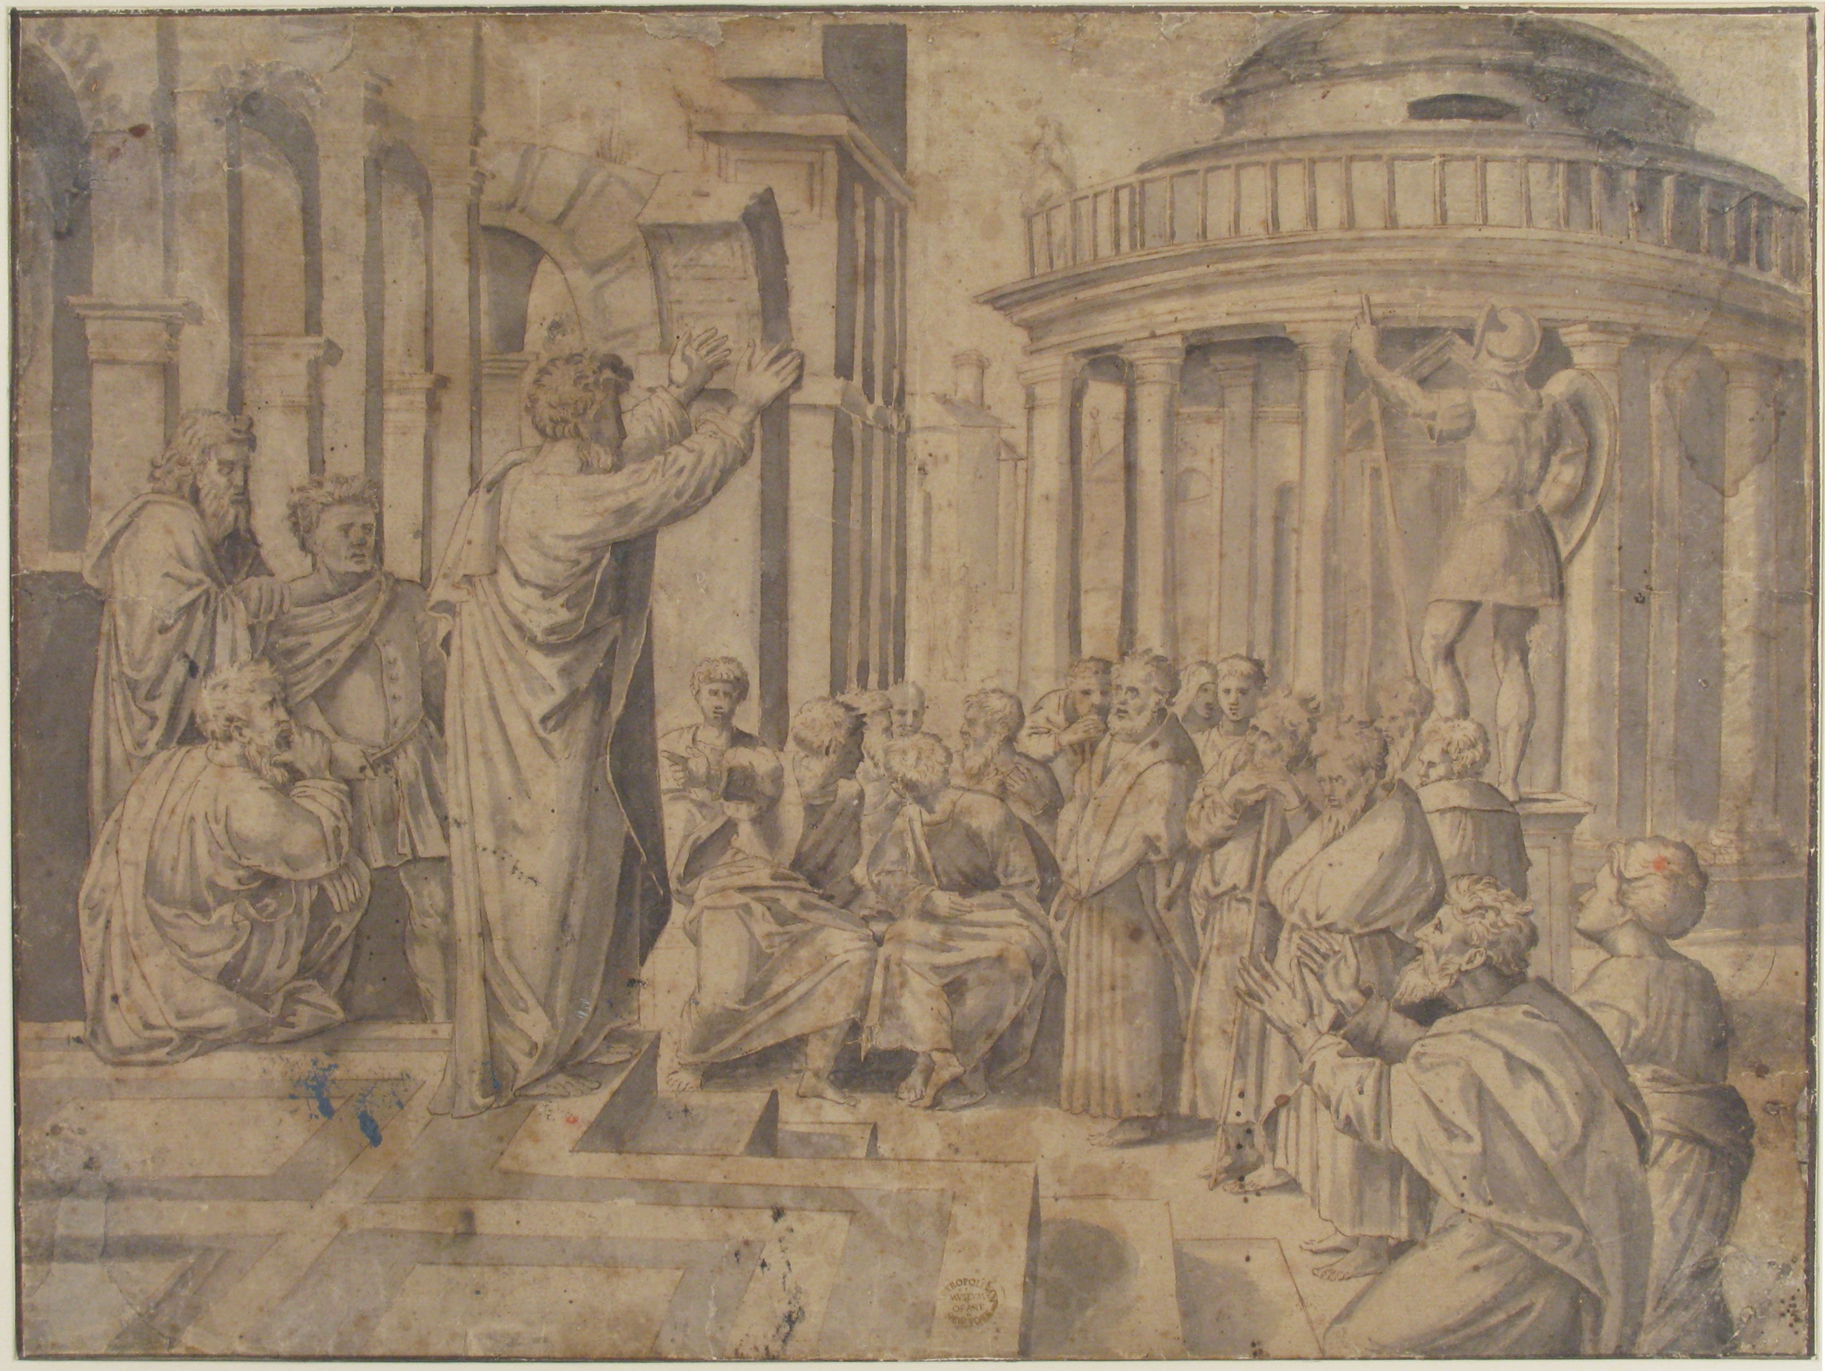
Paul’s Naturalist Sermons
Acts 14:15-17
1. All men have the same nature
Conclusion: all men have the same God

Slide 5
Paul’s Naturalist Sermons
Acts 14:15-17
1. All men have the same nature
2. All nature follows the same rules
Conclusion: One God created all nature

Slide 6
Paul’s Naturalist Sermons
Acts 14:15-17
1. All men have the same nature
2. All nature follows the same rules
3. Nature provides our needs
Conclusion: God provides for us

Slide 7
Paul’s Naturalist Sermons
Acts 17:22-31
1. All life comes from the Creator
Conclusion: we cannot make God(s)

Slide 8
Paul’s Naturalist Sermons
Acts 17:22-31
1. All life comes from the Creator
2. All men have limited lives
Conclusion: God has a purpose for us

Slide 9
Paul’s Naturalist Sermons
From these lessons we learn:
One God created all things
All men have One God
God loves us and provides for us
God has a purpose for us

Slide 10
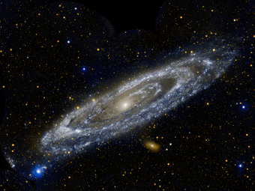
Things Revealed in Nature
The Nature of God
Power without measure
Conclusion:
God’s Divine Power is beyond imagination
Notes:
If God’s power can hold the universe together, then it can accomplish more mundane tasks such as:
Keeping the Bible intact for 3500 years
Raising us from the dead

Slide 11
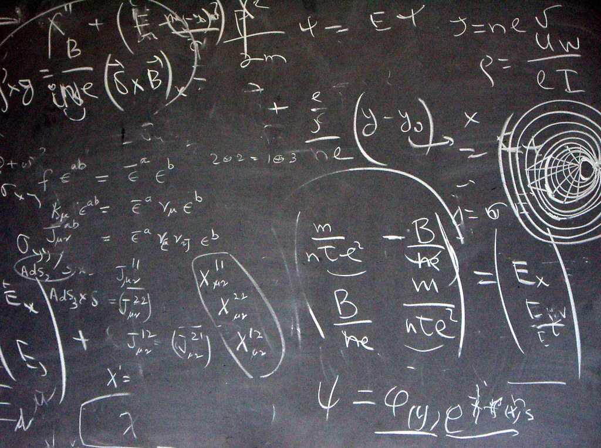
Things Revealed in Nature
The Nature of God and Law
Natural laws are never broken
Spiritual laws are absolute too
Conclusion:
Truth is objective and not subjective
Notes:
Laws of nature are never broken
Jer 33:20 "Thus says the LORD: 'If you can break My covenant with the day and My covenant with the night, so that there will not be day and night in their season, Jer 33:21 'then My covenant may also be broken with David My servant, so that he shall not have a son to reign on his throne, and with the Levites, the priests, My ministers.

Slide 12
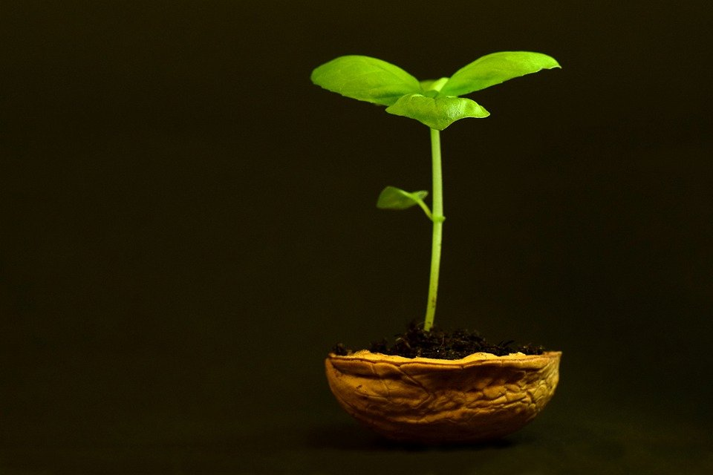
Things Revealed in Nature
The Nature of God’s Promises
God’s natural promises are certain
God’s spiritual promises are certain
Conclusion
God keeps His promises

Slide 14
A Natural Promise of Life
The Word of God is a seed
"Now the parable is this: The seed is the word of God.” Luke 8:11

Slide 15
A Natural Promise of Life
The Word of God is a seed
Our hearts are the soil
Lay aside all filthiness and overflow of wickedness, and receive with meekness the implanted word, which is able to save your souls. James 1:21

Slide 16
A Natural Promise of Life
The Word of God is a seed
Our hearts are the soil
We receive the seed
To believe and confess
To repent of our sins

Slide 17
A Natural Promise of Life
The Word of God is a seed
Our hearts are the soil
We receive the seed
Adding water brings life
"He who believes and is baptized will be saved; but he who does not believe will be condemned” Mark 16:16

Slide 18
A Natural Promise of Life
The Word of God is a seed
Our hearts are the soil
Lay aside all filthiness and overflow of wickedness, and receive with meekness the implanted word, which is able to save your souls. James 1:21

